Slide 1


APPLIED PHYSICS 186 – ACTIVITY 12
MACHINE LEARNING:
perceptron
Professor: Dr. Maricor Soriano
Instructor: Jayson Cubero
Rene L. Principe Jr.
2015-04622

Slide 2
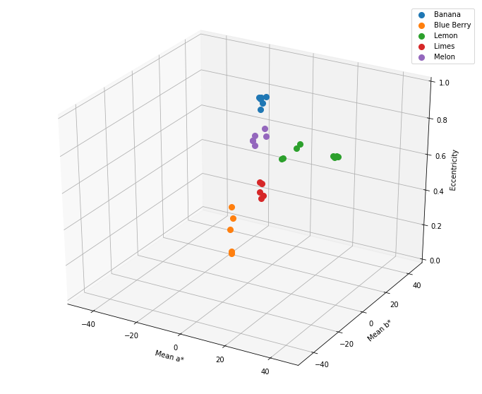
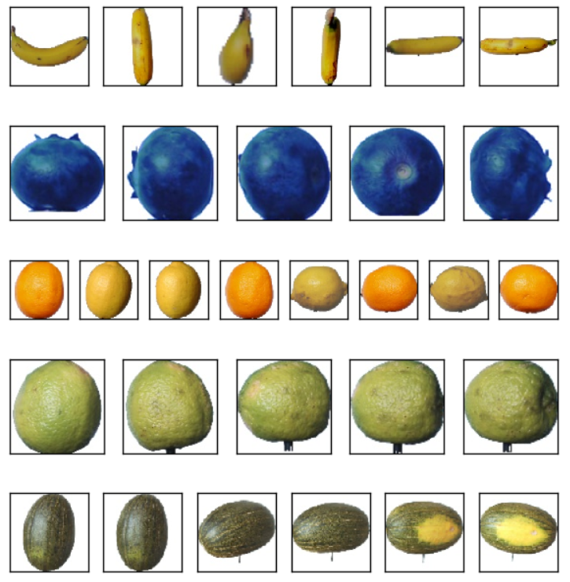
feature extraction
In this activity, we use the perceptron algorithm to create a decision line between two classes using the trained weights. The weights were initialized to be zero and the model’s learning rate was 0.1. Threshold iterations was set to be 100 times. After the training, decision line was plotted.
Initially, I have 3 features namely: a*, b* and eccentricity. To facilitate the creation of decision line, I reduced a* and b* into a single feature channel “Hue” which is measured in degrees from 0 to 360 by taking the arctan(b*/a*). This representation is analogous to ROYGIBV where R is near 0 while V is near 360. The reduced color space is shown in Fig. 2. Hence, decision lines for each classes was now calculated using the hue and eccentricity features.
Figure 1. Combining the features, a 3D feature space was plotted above where a* measures the greenness to redness, b* measures the blueness to yellowness, and eccentricity measures how elliptical the fruits are.

Slide 3
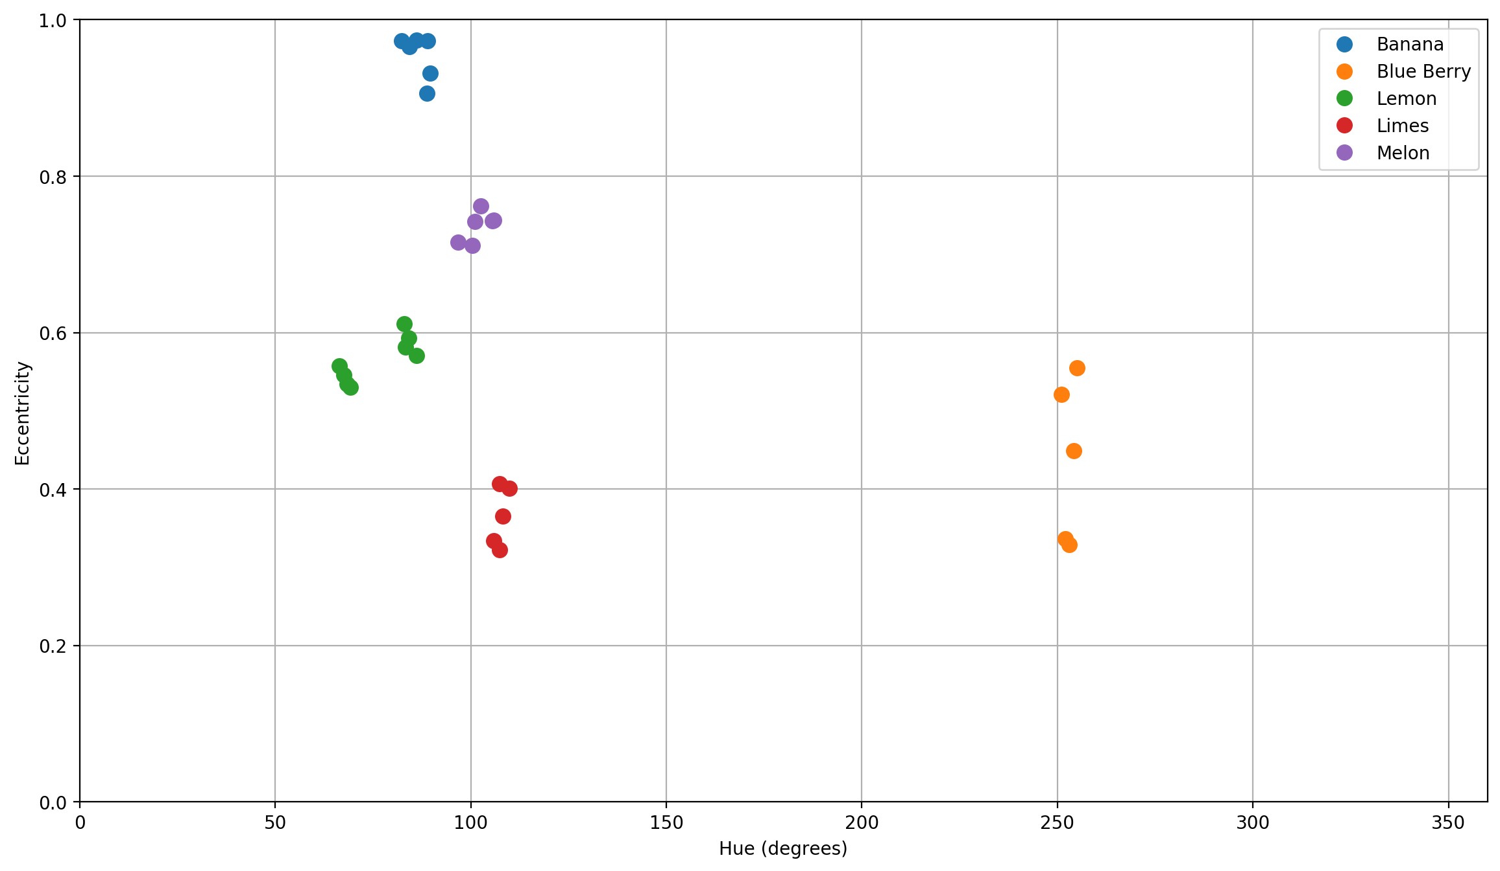
Figure 2. Eccentricity vs Hue feature space on the five fruit classes was plotted. Not to scale but the sequence of increasing Hue is analogous to ROYGBIV.

Slide 4
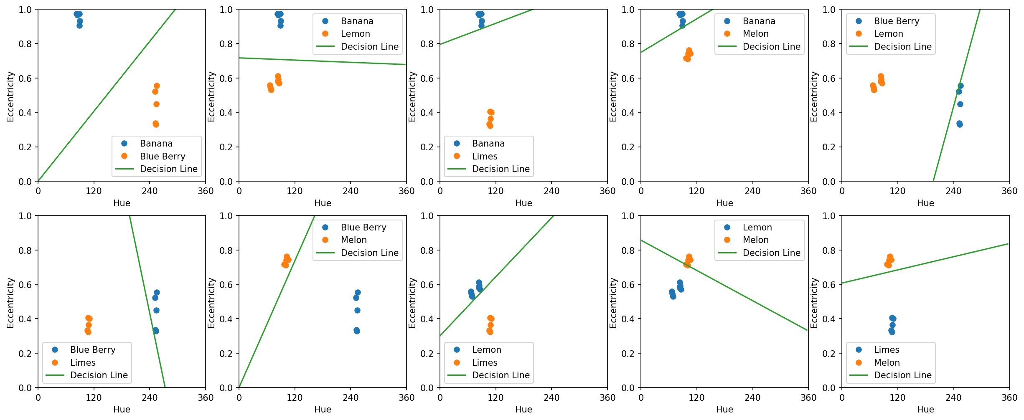
Figure 3. .For each pair of fruit classes, a perceptron was trained and decision line was plotted using the final weights. There were ten decision lines in total to classify five fruits from each other.

Slide 5
After extracting the features, decision lines were successfully plotted using the weights from the Perceptron Algorithm.
In this activity, I’d give myself an 11 for classifying five fruit classes.
References:
[1] M. Soriano, “Perceptron”, 2019.
[2] M. Oltean and H. Muresan, Fruits 360 dataset on kaggle. [Online; accessed 29.10.2019].
Figure 4. Combining the features, a 3D feature space was plotted above where a* measures the greenness to redness, b* measures the blueness to yellowness, and eccentricity measures how elliptical the fruit is.

